Slide 1
Chapter 2 Discrete-Time System Analysis in the Time Domain
§2-1 Linear Input/Output Difference Equations with Constant Coefficients
§2-2 Discretization in Time of Differential Equations
Problems

Slide 2
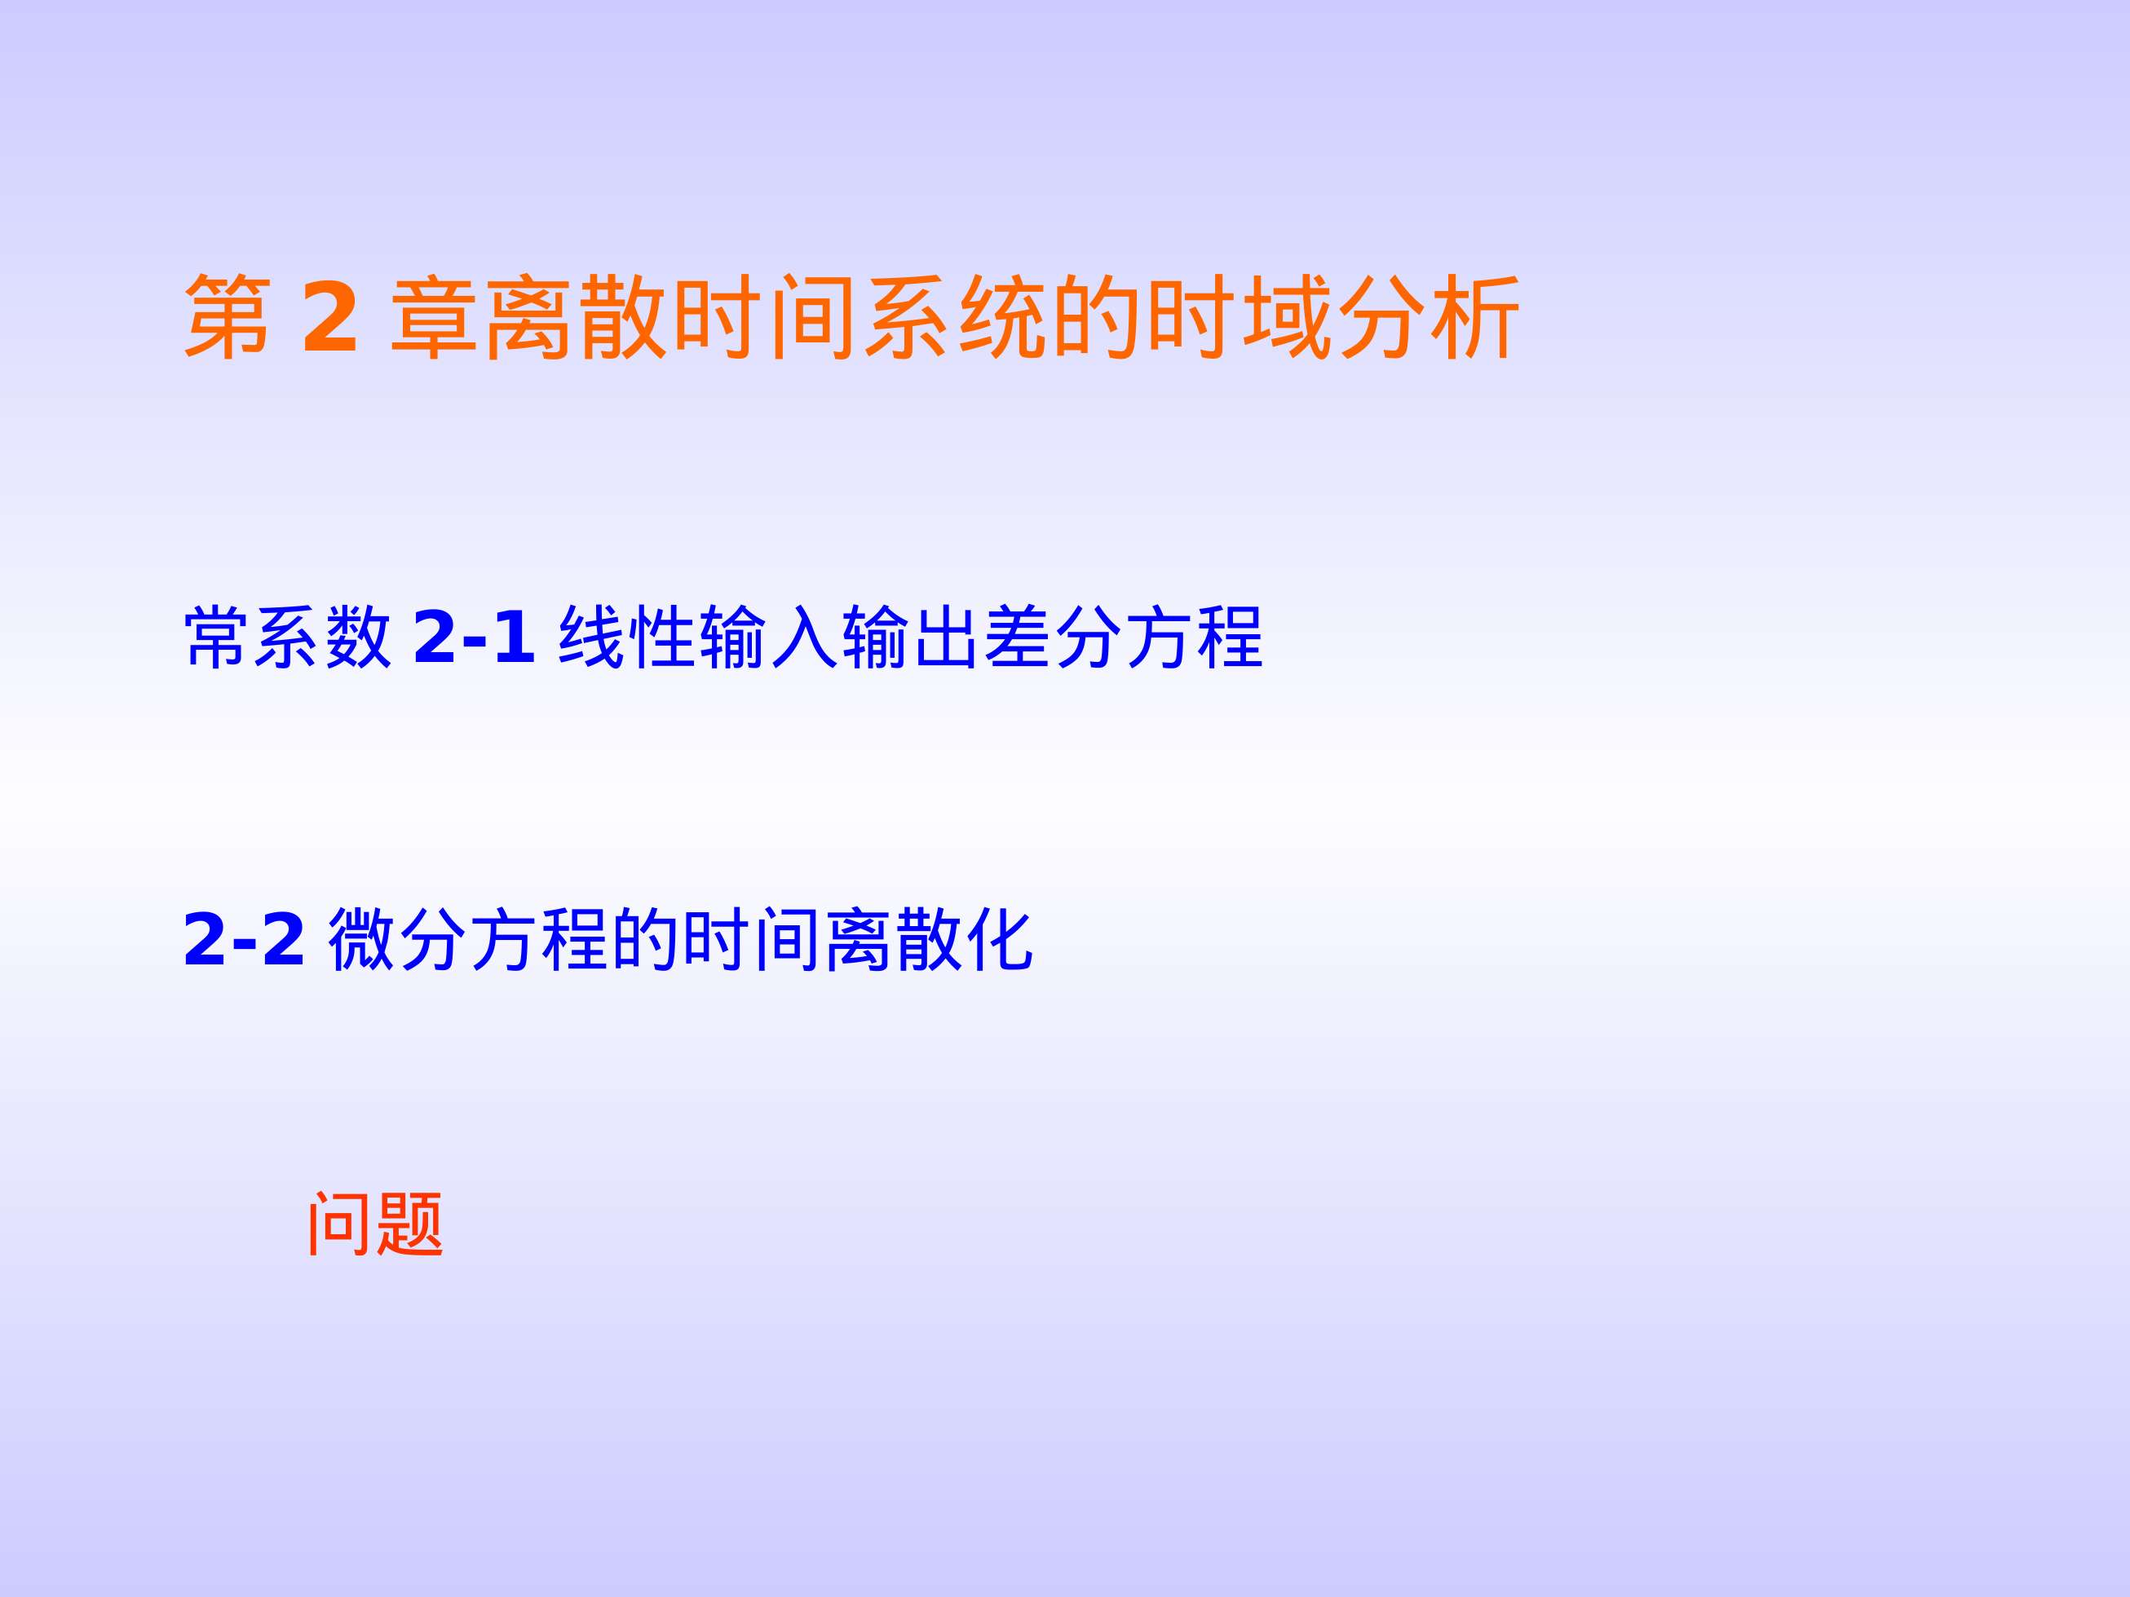

Slide 3

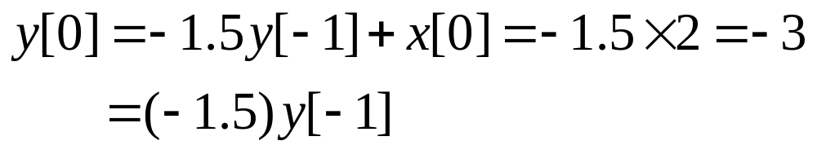
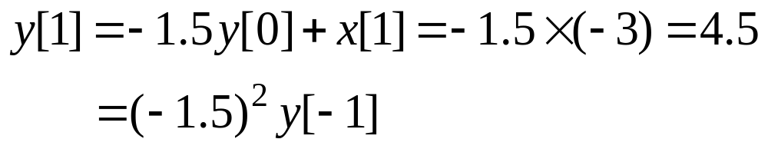
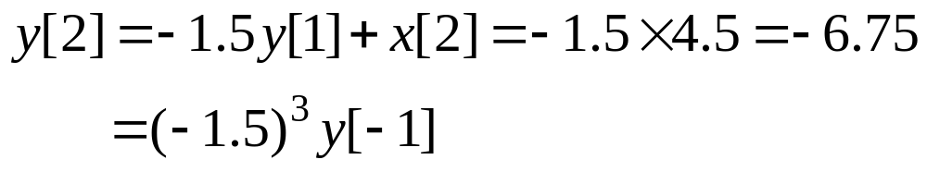
Problems and Solutions
2.1 For the difference equation y[n]+ 1.5y[n –1]= x[n], use the method of recursion to compute y[n] for n=0, 1, 2, 3, when x[n]=0 for all n and y[–1]=2, and then find a complete solution for y[n].
Solution:
When n=0,
When n=1,
When n=2,

Slide 4
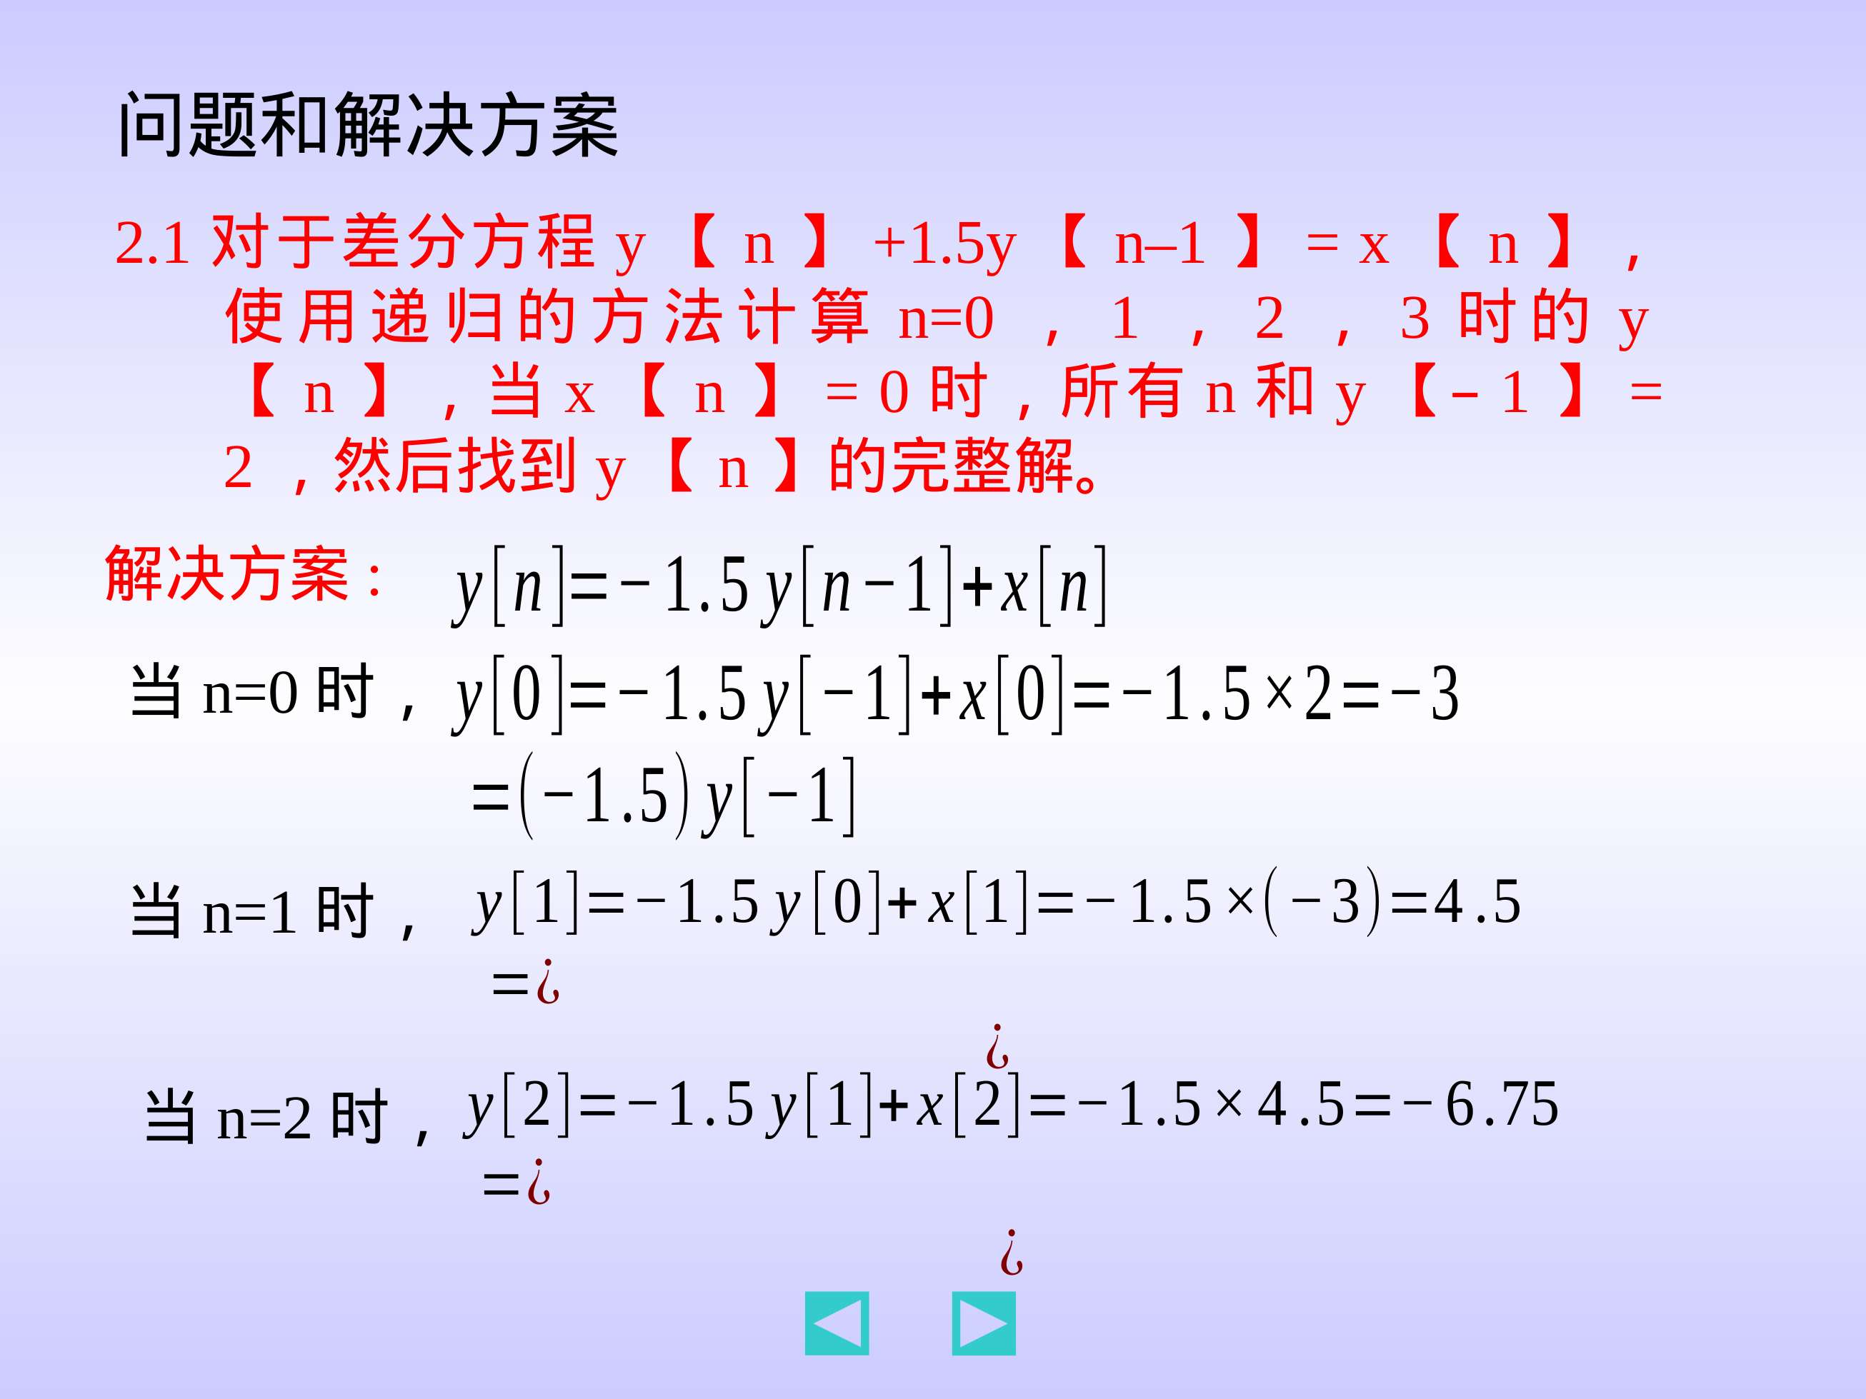

Slide 5
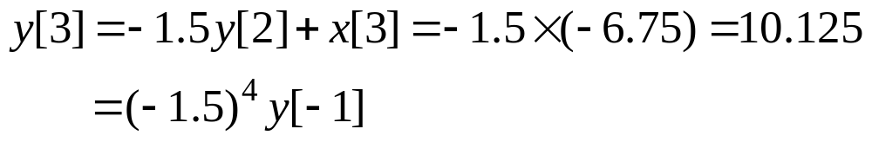
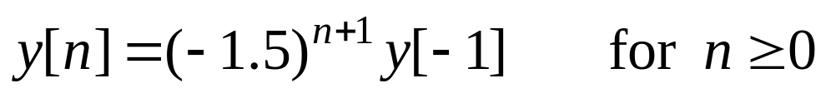
Solution:
When n=0,
When n=1,
When n=2,
When n=3,
We can see that the complete solution of y[n] is:

Slide 6
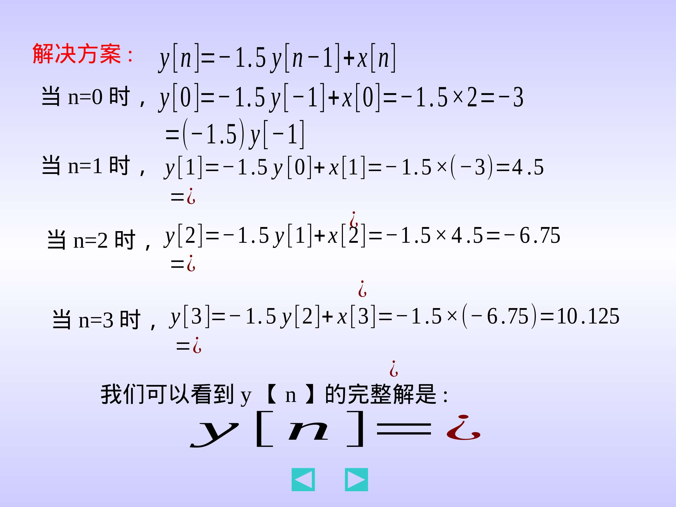

Slide 7
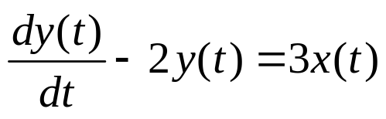
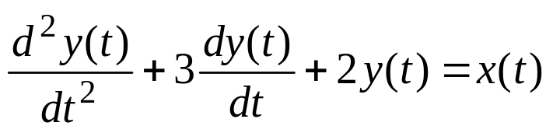
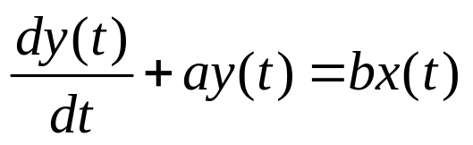

2.2 Consider the following differential equations:
(a)
(b)
Using Euler’s approximation of derivatives with T arbitrary and input x(t) arbitrary, derive a difference equation model.
Solution:
2.2(a) For the given input/output differential equation
the Euler’s approximation is:

Slide 8
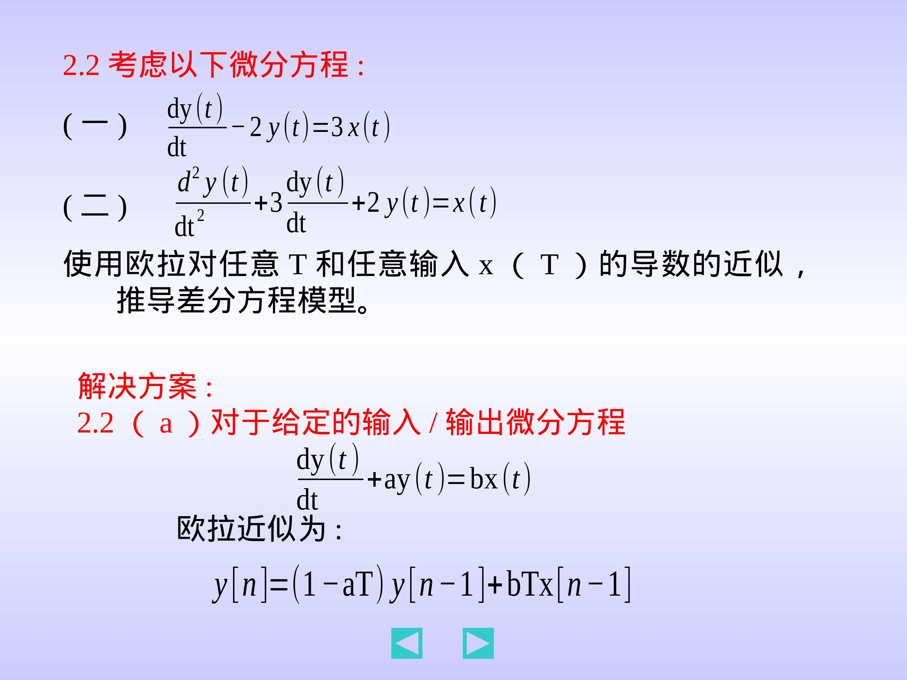

Slide 9

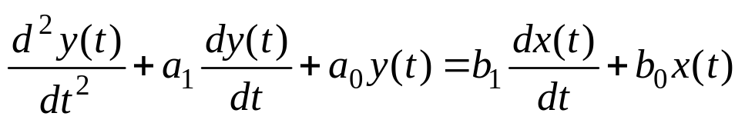
where a=−2, b=3, T is a fixed positive number (time sampling interval). Thus, the difference equation model is:
Solution:
2.2(b) For the given input/output differential equation
the Euler’s approximation is:
y[n] +(a₁T – 2) y[n – 1]+ (1– a₁T + a₀T²) y[n – 2]
= b₁T x[n – 1]+( b₀T² –b₁T) x[n – 2]
where a₁=3, a₀=2, b₁=0, b₀=1, T is a fixed positive number (time sampling interval). Thus, the difference equation model is:
y[n] +(3T – 2) y[n – 1]+ (1– 3T + 2T²) y[n – 2]= T²x[n – 2]

Slide 10
